Slide 1


The Undertaker
NEW GAME
TUTORIAL
TEAM “NEW ORLEANS
LEADER BOARD

Slide 2
ABOUT THE UNDERTAKER

Slide 3

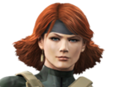
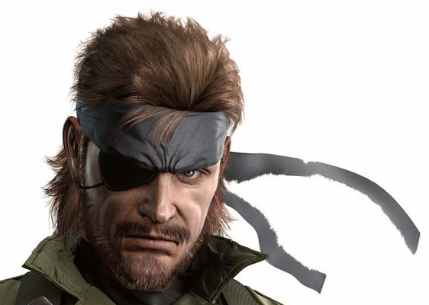
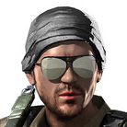

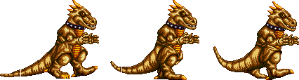
THE TEAM
SIMEON
VANOV
VIKTORIA
TENEVA
EDWARD
SLAVOV
VIKTOR
MARINOV
KIRIL
TODOROV
Made player sprite sheet, moving and jumping, added bullets and basic collision,

Slide 4

AND THANK YOU FOR YOUR ATTENTION!

